Slide 1
ARTISAN
9
555
ARTISAN
ART ISAN
STUDIOS
ARTISAN
ARTISAN
56

Slide 2
ABOUT US
Company Name: Artisan Studios
Artisan is a skilled person that does arts and crafts in a traditional way or by using their hands.
We are a typical college students’ clique. We share the same interests like gaming, problem solving and creating our own version of things. We like doing things from scratch but just like everyone, we also need help from our peers that is why we decided to team up. Our circle is stern yet democratic for we maintain our standards when doing things but also allow any proposition and decide as one.
ARTISAN
9
555
ARTISAN
ARTISAN
ARTISAN
56

Slide 3
ARTISAN
9
555
Mission
To establish a company capable of creating and developing games that captivate the audience through its accessibility and uniqueness. To provide an engaging community that actively promotes critical-thinking and allows each other to freely communicate and cultivate companionship. To continuously grow individually while maintaining harmony as a team; leaving a distinction in the gaming community.
ARTISAN
Vision
We will be renowned game developers and be included and regarded as one of the best in the industry.
ARTISAN
ARTISAN
56

Slide 4
Logo Theme and Symbolism
Fire – The dedication and skill that every member of the company reflects.
Wood – The stability, hardness, and continuity of the game.
Metal – Binds the ability of each member that supports the company.
Light – The entertainment and the knowledge that the games give off to the players.

Slide 5


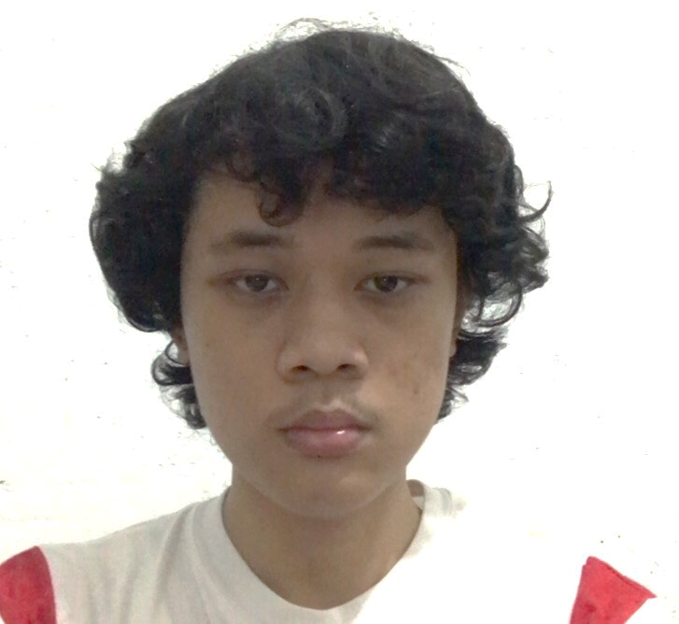

COMPANY STRUCTURE
ARTISAN
9
555
ARTISAN
John Lexter S. Panti
James Christopher Corpuz
Angelo Hugo
Noerick Sentillas
Back-End Programmer
Back-End Programmer
Business Analyst
Front-End Programmer
ARTISAN
ARTISAN
56

